Slide 1
MOVIE SEAT BOOKING
TS- WEB/CC/AI TRACK CAPSTONE PROJECT
Presented By:
19KA1A0212-S M NAGALAKSHMI
Guided by
R. Uma Maheshwari

Slide 2
OUTLINE
Abstract
Problem Statement
Aims , Objective & Proposed System/Solution
System Design
System Development Approach
Project outcome
Conclusion
References

Slide 3
Abstract
Finding a suitable movie to watch with our family on weekend or with our loved ones is on of the confused task nowadays and is a big task for booking a suitable seat for your family so that you can sit together to watch the film with your family or the loved ones. It is one of the big headaches to book the movie tickets, check for the available seats, comfortable seats so that you can enjoy your movie and the movies that are available at present. Movie seat booking website certainly made possible for everyone to fulfil the above the requirements.
They are the fastest source to communication reaching wide range of audience on just a single click irrespective of their location as it shows the available movies shows near you. This web application “Movie Seat Booking” provides an easy and convenient search application for the movie lovers and family to book their movie seats that are comfortable to them.

Slide 4
Problem Statement
This project is aimed at developing a web-based Movie Seat Booking for the HR Group for a company.
This document provides details about the entire software requirements specification for the online Movie Seat Booking. The project Online Movie Seat Booking is aimed at developing a web-based Movie Seat Booking system for the HR Group of a company

Slide 5
Proposed Solution
In simple words, this web-based application provides the chance to book the movie seats of the theatre according to their choice and this update the price of the selected movie.
The customers can select the movie according to their choice for the available show. They can select or deselect the seats of their choice and also they can view the occupied and unoccupied seat in the theatre through this application.

Slide 6
SYSTEM ARCHITECTURE
USER
LIST OF MOVIES
SELECTION OF MOVIE
SELECTION OF SEATS
PRICE UPDATE

Slide 7
SYSTEM DEPLOYMENT APPROACH
FRONTED DEVELOPMENT
HTML
CSS
BOOTSTRAP
JAVASCRIPT

Slide 8
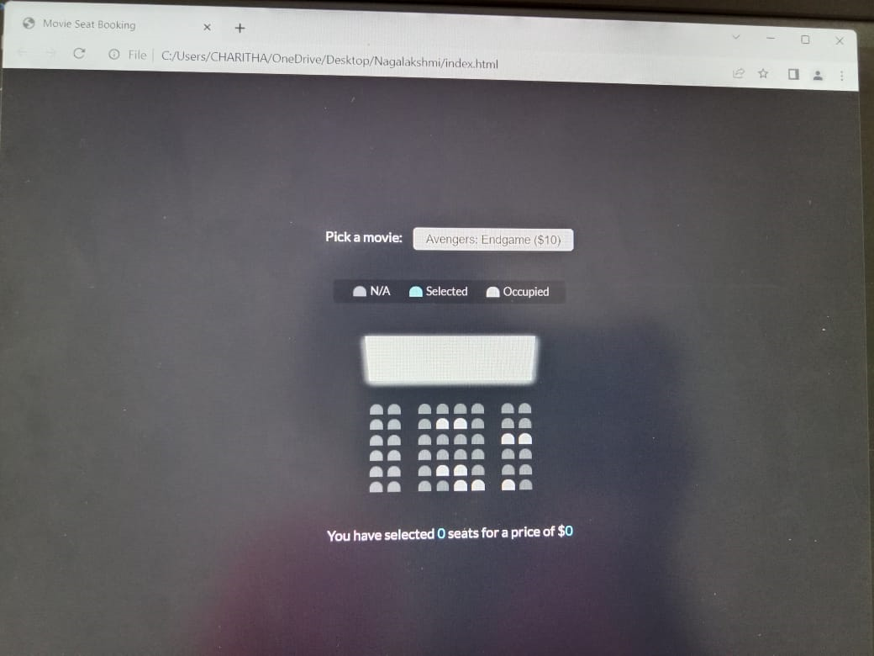
PROJECT OUTCOMES

Slide 9
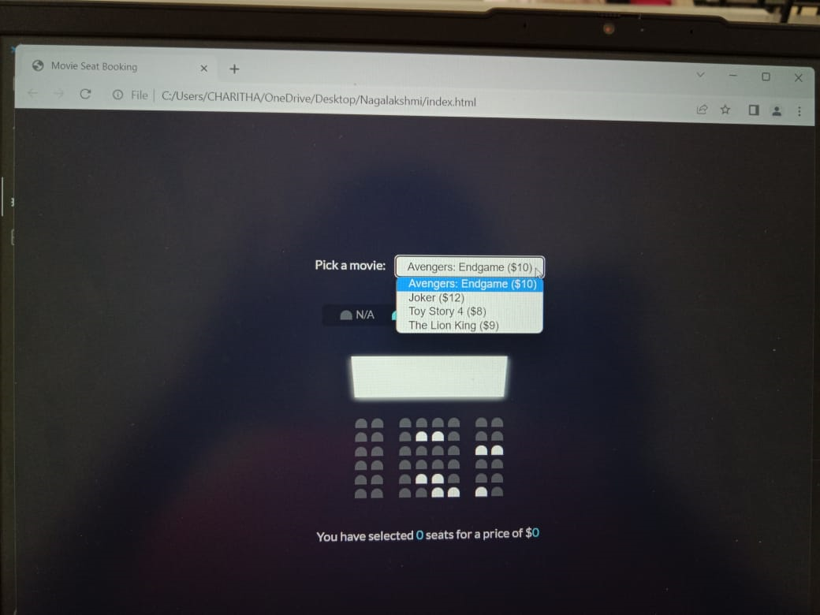

Slide 10
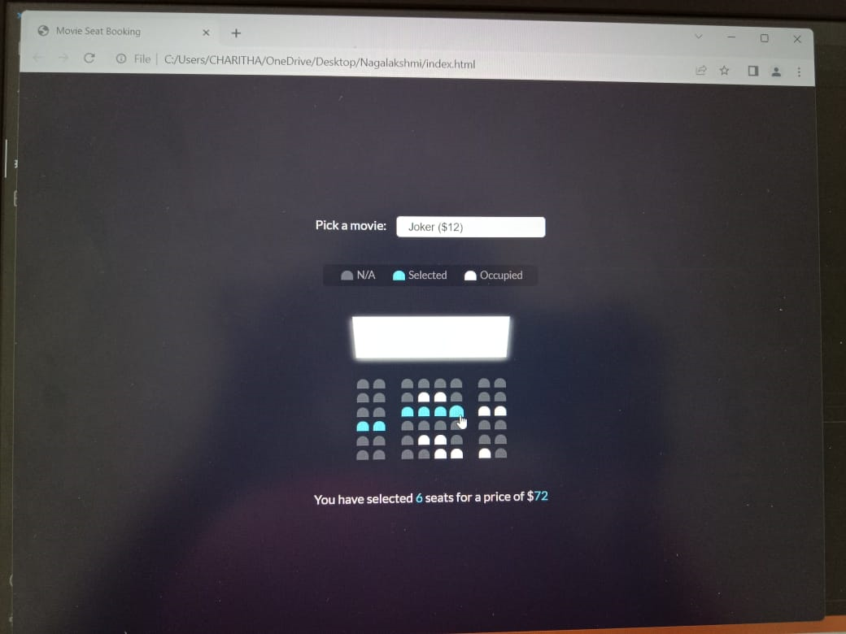


Slide 11
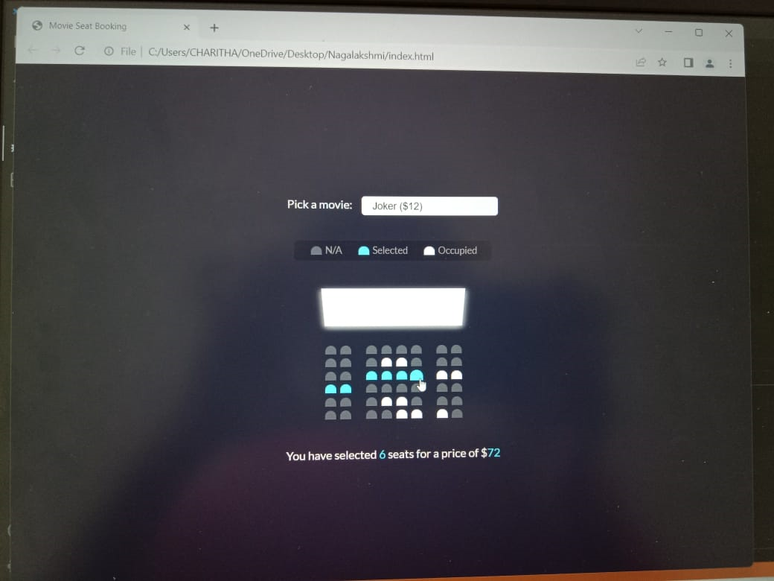

Slide 12
CONCLUSION
Hence, this online Movie Seat Booking application displays movie choices and seats in a theatre to select from in order to purchase tickets. This project describes a movie seat booking system designed as a kiosk which customers can use at local shopping areas prior to going to the movie to pre-book movie seats for the film of their choice. This could reduce costs allowing for the less staffing costs.

Slide 13
REFERENCES
https://www.researchgate.net/publication/361465446_Application_using_MERN_Stack
https://blog.bitsrc.io/build-a-full-stack-banking-web-app-with-plaid-the-mern-stack-508914ce5694
https://javascript.plainenglish.io/create-a-fullstack-banking-application-using-react-e8c96d74cd39

Slide 14
THANK YOU

